Slide 1
Grants Symposium

Slide 2
History
Mission
  Deliver the services of the Federal Government in the most cost-effective manner practical
Most federal agencies have narrow authority for very specific projects
  Makes comprehensive projects difficult and real needs of communities difficult to address
Denali Commission’s broad authority can fill that gap
Denali Commission authority:
  Job Training,
  Economic Development,
  Rural development, energy and transmission infrastructure, communications systems, water and sewer systems and other infrastructure needs

Slide 3
Structure
6 Commissioners:
    State of Alaska Co-Chair: Tyson Gallagher
    Alaska Federation of Natives: Julie Kitka
    Alaska Municipal League: Nils Andreassen
    American Federation of Labor and Congress of Industrial Organizations - Alaska: Joelle Hall
    University of Alaska: Pat Pitney
    Alaska General Contractors: Alicia Amberg
Staff
  The goal of the agency – lean & mean
  High level subject matter experts
  Maximize use of dollars on the program side

Slide 4
Denali Commission Special Tools
Transfer Authority
  Authority to accept funds from non-federal and federal sources
  Agencies counts funds as expended, eliminating Congress’s ability to rescind funds
  Other Special Provisions are applied once transferred to D.C
Non-Federal Cost Share Match
  Ability to match funds with other federal agencies
  Acts like private or state funds
No-Year Funds
  Do not expire at end of fiscal year
  Allows for long-term projects

Slide 5
Past investments
Investments:
  Housing, transportation, bulk fuel, power generation, sanitation, health facilities, critical infrastructure and development projects
  $1.1 billion invested in 230 communities over 20 years

Slide 7
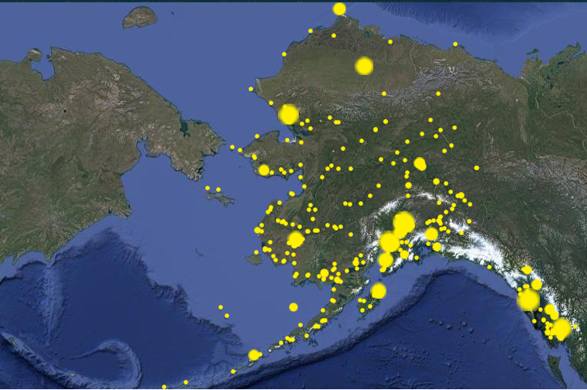

Slide 8
FY23 Workplan
Funding levels
  Energy: $4.925 M
  Bulk fuel: $2.2 M
  Village infrastructure protection: $500,000
  Transportation: $500,000
  Sanitation: $1.5 M

Slide 9
FY23 workplan
  Health facilities: $500,000
  Housing: $500,000
  Broadband: $250,000
  Workforce/economic development: $1.6 M
  New flexible funding: $1.325 M
    Allows the Commission to move money around to meet needs

Slide 10
IIJA Workplan
  Energy: $1 million per year FY22-26
  Village Infrastructure: $1 M per year, FY22-26
  Workforce Development: $250,000 per year, FY22-26
  Infrastructure Fund: $10 M per year, FY22-26
  Emergency Funds: $500,000 per year, FY22-26

Slide 11
Upcoming Funding
Funding Opportunity:
    Energy
    Transportation
    Health/community wellness facilities
    Village infrastructure protection
    Water/sanitation
    Housing
    Broadband
    Economic Development

Slide 12
Upcoming Funding:
  Workforce development
  “Infrastructure fund”
    This includes any sort of infrastructure and workforce development.
    We have a draft workplan up on our website for our IIJA funding right now. Must be approved by the Department of Commerce before we can issue awards.

Slide 13
Working with the Commission
Best thing we can do is hear from you
Tell us more about your needs
  www.denali.gov for contact info and funding requests
  Draft FY23 and IIJA work plans are up for public comment
  Public hearing on April 21, from 10 AM to 12.

Slide 14

Thank You!
Garrett Boyle
907-271-1414; gboyle@denali.gov
www.Denali.gov

