Slide 1
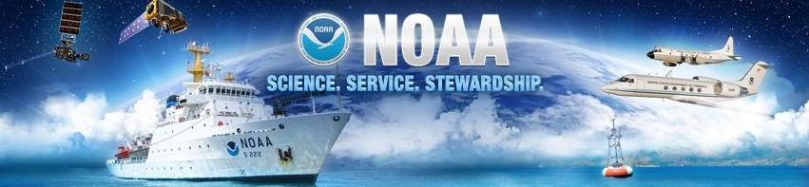
NOAA’s Infrastructure Investment and Jobs Act Updates
—
Daniel A. Namur
Director, NMFS Financial Assistance Division
NOAA Fisheries Office of Management and Budget
National Oceanic and Atmospheric
Administration
noaa.gov

Slide 2
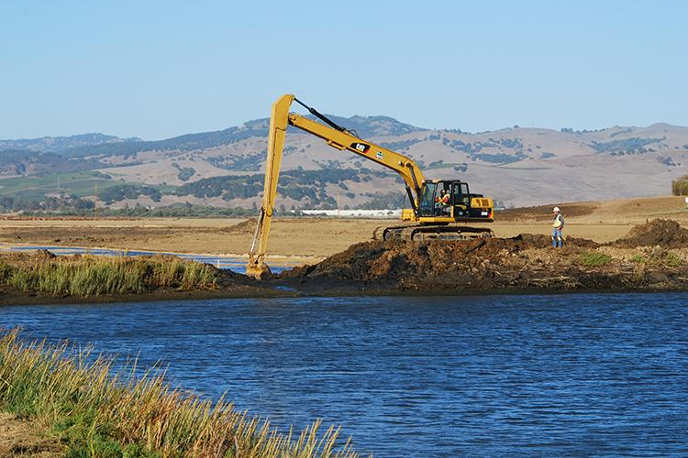
Overview of NOAA & IIJA
Infrastructure Investment and Jobs Act signed into law November, 2021: $1.2 trillion
Provides roughly $3 billion for NOAA over 5 years through 18 provisions across several NOAA offices
Several provisions focus on funding that will be available through competitive grant programs to make a difference for fisheries, threatened and endangered species, and coastal communities across the country
Notes:
States would be eligible to apply for funding.

Slide 3
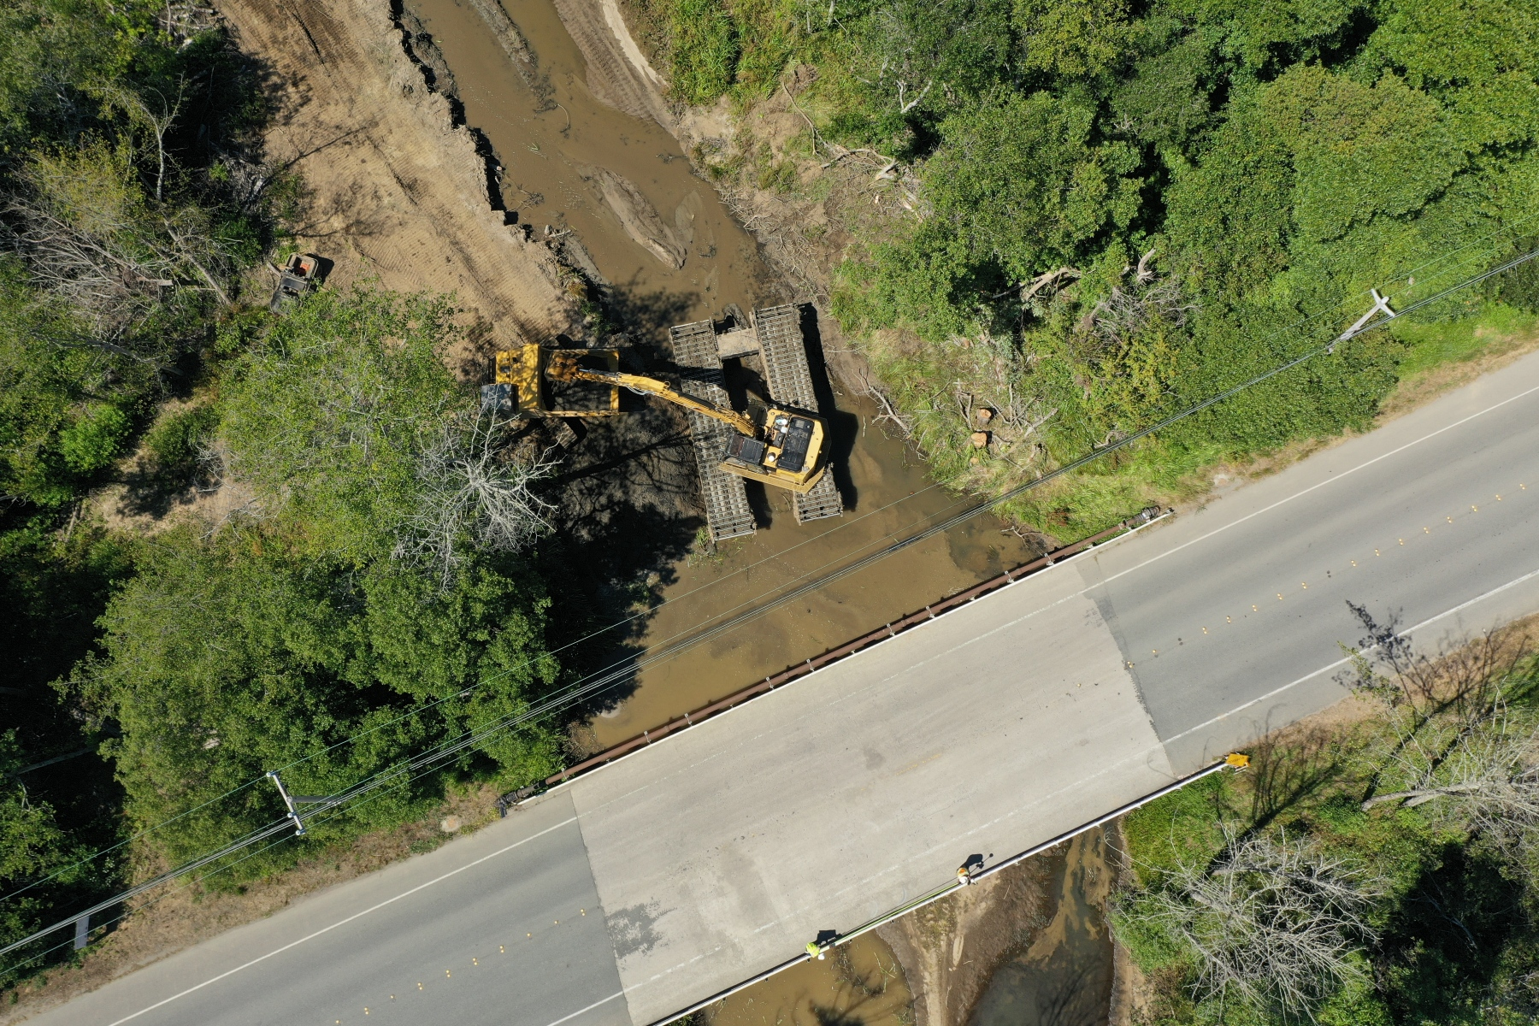
Provision: Habitat Restoration and Resilience
$491M over 5 years
Competitive grant program for restoring marine, estuarine, coastal, or Great Lakes ecosystems, using approaches that enhance community resilience to climate hazards
Lead: NOAA Fisheries’ Office of Habitat Conservation

Slide 4
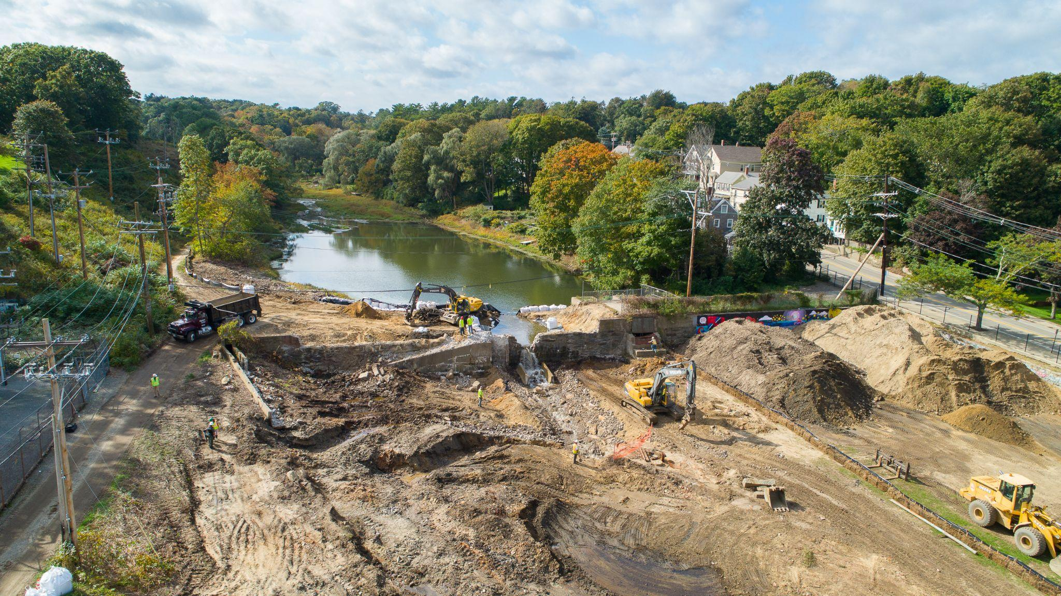
Provision: Restoring Fish Passage
$400M over 5 years
Competitive Grant Program for restoring fish passage by removing in-stream barriers and providing technical assistance through the Community-based Restoration Program
Up to 15 percent reserved for federally recognized tribes and Alaska Native corporations
Lead: NOAA Fisheries’ Office of Habitat Conservation

Slide 5
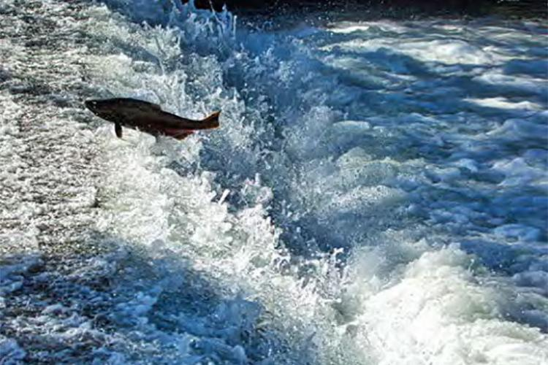
Provision: Pacific Coastal Salmon
Recovery Fund
$172M over 5 years
For an additional amount for ‘‘Pacific Coastal Salmon Recovery.’’
  Competitive grant program for States and Tribes to protect, conserve, and restore salmon and steelhead populations and their habitats.
Lead: NOAA Fisheries’ West Coast Region
Notes:
HL: Is the $172M more funding above the $60M that is usually put to this annually? yes

Slide 6
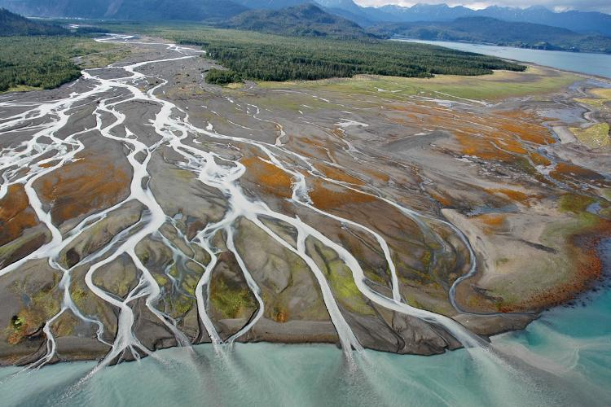
Additional NOAA Funding
National Oceans and Coastal Security Fund Grant Program
  $492 million over 5 years
Habitat Restoration - Coastal Zone Management Program
  $207 million over 5 years
Habitat Restoration - National Estuarine Research Reserves
  $77 million over 5 years
Regional Ocean Partnerships for the coordination of interstate and intertribal management of ocean and coastal resources.
  $56 million over 5 years
Notes:
The Office of Habitat Conservation (OHC) collaborates with offices and programs across NOAA to successfully plan and implement complex restoration projects that benefit fisheries and communities. Through the various funding elements of IIJA, we look forward to continuing to work closely with our NOAA partners to coordinate our efforts and make a collective impact for coastal habitats and communities.
[Internal Note] National Oceans and Coastal Security Fund Grant Program – It may be helpful for our partners to identify the National Oceans and Coastal Security Fund Grant Program as the NOAA partnership with National Fish and Wildlife Foundation (NFWF) for the National Coastal Resilience Fund.
[Internal Note] Interest in other NOAA programs and partners – Many programs within NOAA will be executing habitat related infrastructure funding which may lead to some confusion for our partners. Please encourage them to reach out to our colleagues in those offices directly for now. We hope to have resources soon for partners with information about all of the different funding opportunities. You can also note our strong relationship and collaborative nature with our NOAA colleagues.

Slide 7
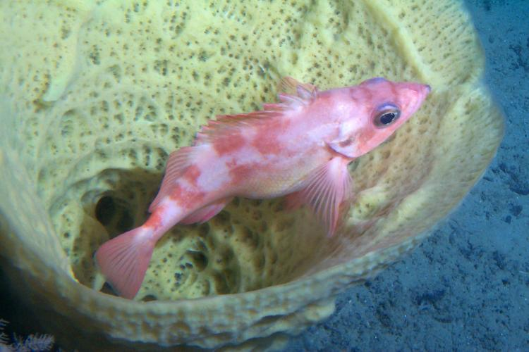
What is the status of the IIJA Implementation?
As required by the Infrastructure Investment and Jobs Act, NOAA has developed spend plans for each relevant provision for FY 2022 and is awaiting their approval.
We anticipate that more information on specific funding opportunities will become available in the coming months and would be happy to notify you once those have been shared publicly.
Notes:
The Office of Habitat Conservation (OHC) collaborates with offices and programs across NOAA to successfully plan and implement complex restoration projects that benefit fisheries and communities. Through the various funding elements of IIJA, we look forward to continuing to work closely with our NOAA partners to coordinate our efforts and make a collective impact for coastal habitats and communities.
[Internal Note] National Oceans and Coastal Security Fund Grant Program – It may be helpful for our partners to identify the National Oceans and Coastal Security Fund Grant Program as the NOAA partnership with National Fish and Wildlife Foundation (NFWF) for the National Coastal Resilience Fund.
[Internal Note] Interest in other NOAA programs and partners – Many programs within NOAA will be executing habitat related infrastructure funding which may lead to some confusion for our partners. Please encourage them to reach out to our colleagues in those offices directly for now. We hope to have resources soon for partners with information about all of the different funding opportunities. You can also note our strong relationship and collaborative nature with our NOAA colleagues.

Slide 8
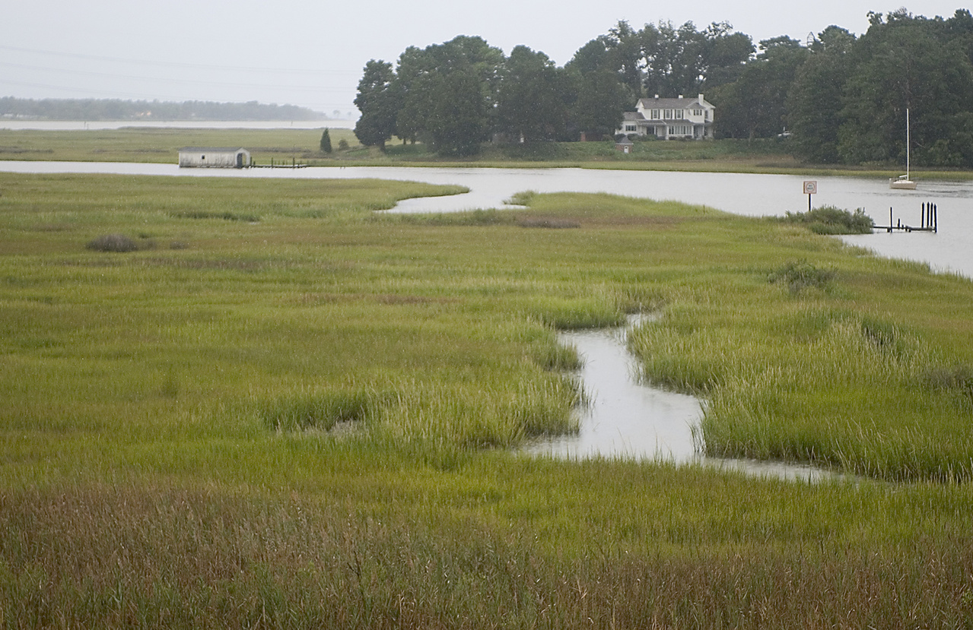
Thank You!
Daniel A Namur
Director, NMFS Financial Assistance Division
NOAA Fisheries Office of Management and Budget
Dan.Namur@NOAA.gov
301-427-8730
Notes:
Thank you for your time today.
I’m happy to take your questions.
More information about Infrastructure Bill from White House website - much of NOAA’s provisions fall under resilience section: https://www.whitehouse.gov/build/
https://www.whitehouse.gov/wp-content/uploads/2022/01/BUILDING-A-BETTER-AMERICA_FINAL.pdf#page=269
From Heidi - questions I might expect (probably not much different than other groups):
You mention early input from Tribes. Will there be a similar process for States? IIJA had explicit direction regarding Tribes and so that’s why those early steps have been taken. I’m happy to take your question about States back to the team.
Is a prioritization process being developed? Will the agency seek stakeholder/state engagement in setting and addressing goals or priorities? Again, we are very early in this process and I don’t believe this level of detail has been determined.
Do you have more details about the purpose or goals of the various programs? How the funds could be used? No, I don’t.
Will the agency be focusing on critical habitat for high priority endangered or threatened species (i.e., adding emphasis to Species in the Spotlight) or all Listed species? I don’t know that NOAA’s gotten to level yet. I can take your question back to the team.
How much does the agency expect to focus on habitat important to fisheries compared to habitat important to protected species? I would expect both to be important.
Will funds be added to existing competitive grant programs or will they all be new programs (beyond the PCSRF)? In the case of the fish passage funding, there is explicit direction in the language to execute through the Community-based Restoration Program authorized by the Magnuson Act. Not all of the provisions are specific.
Have any timelines been set? When does NMFS expect to be have these funding opportunities on the street, open for solicitation? I don’t know. I would encourage you to start thinking about projects that might be ripe for these competitions.
https://docs.google.com/spreadsheets/d/1v51WWBfZUmo64x-kSB0_38Wpf_5-9zGGYmCuiathZDU/edit#gid=1027138343
https://www.whitehouse.gov/build/
https://www.whitehouse.gov/wp-content/uploads/2022/01/BUILDING-A-BETTER-AMERICA_FINAL.pdf#page=269

